Slide 1


Deploying a static website using Azure Storage Account
PRESENTED BY:
MSSPR SURYA ABHAY
MOHAMMAD ABDULLAH SHAREEF
MOHAMMAD MUZAMMIL
MOGHAL FEROZ BAIG

Slide 2
INTRODUCTION
Hosting a static website on Azure Storage is a straightforward, cost-effective solution for lightweight web applications like personal blogs, portfolios, or documentation. This guide walks you through the process of creating and deploying a static website using Azure's Storage Account service.

Slide 3
Overview
Key Concepts:
Azure Storage Account: The foundational resource that stores website content.
Static Website Feature: A special feature that enables direct hosting of static files from the Azure Storage Account.
$web Container: A designated container within the Storage Account that hosts website files.
Primary Endpoint: A public URL that provides access to the static website.

Slide 4
IMPLEMENTATION
Create a Storage Account:
Choose a subscription, resource group, and region to create the Storage Account.
Configure the performance and redundancy options.
Complete the creation process through the Azure Portal.

Slide 5
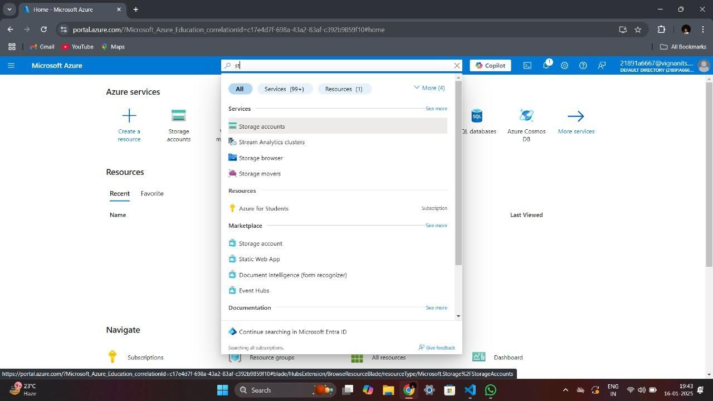

Slide 6
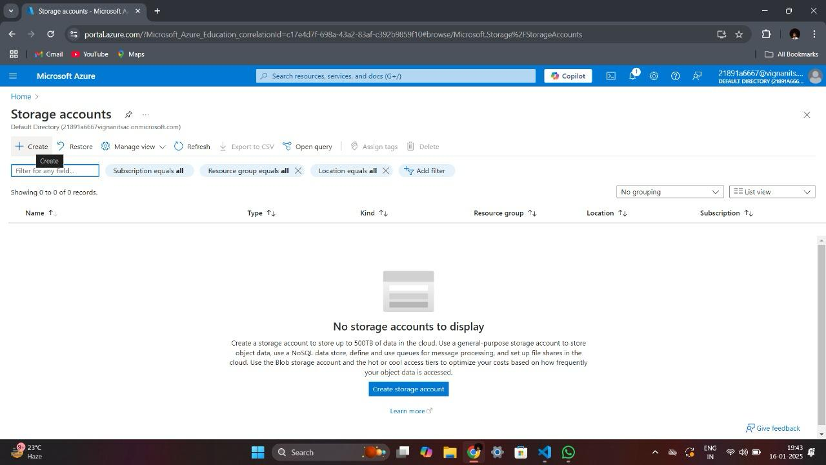

Slide 7
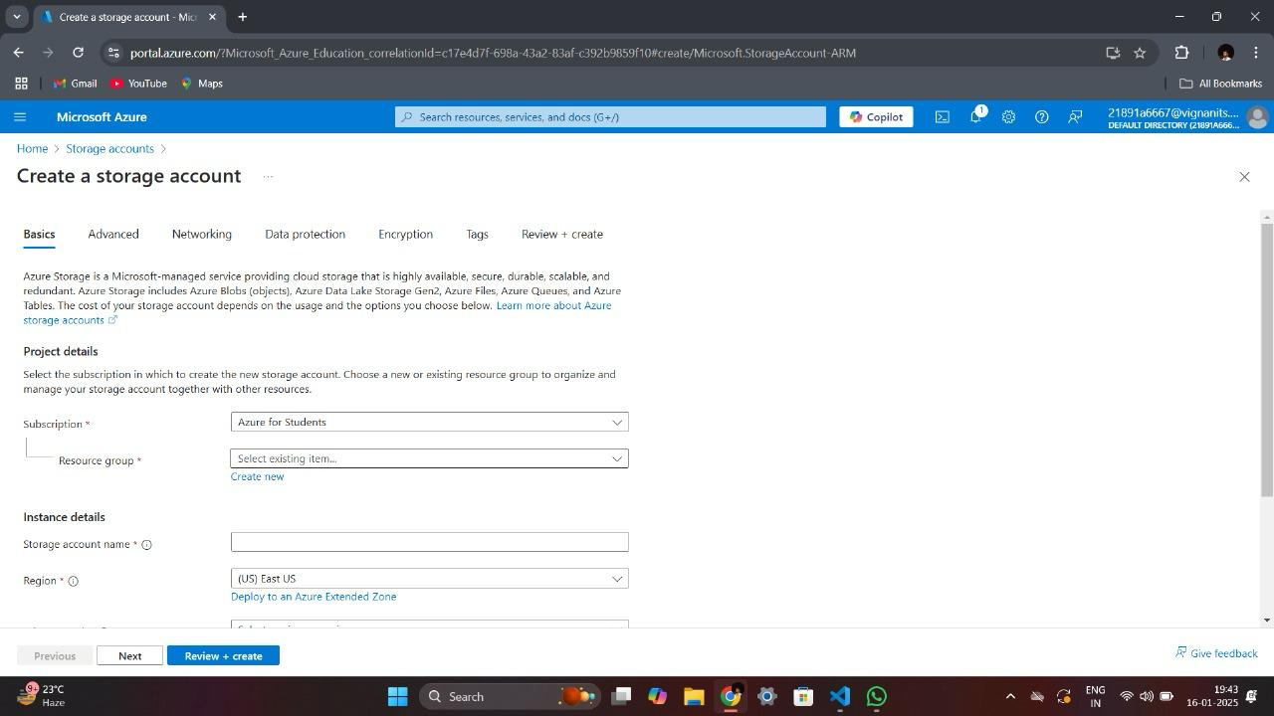

Slide 8
Create a Web Page:
Develop an HTML file
Add content, styling, and structure for the static website.

Slide 9
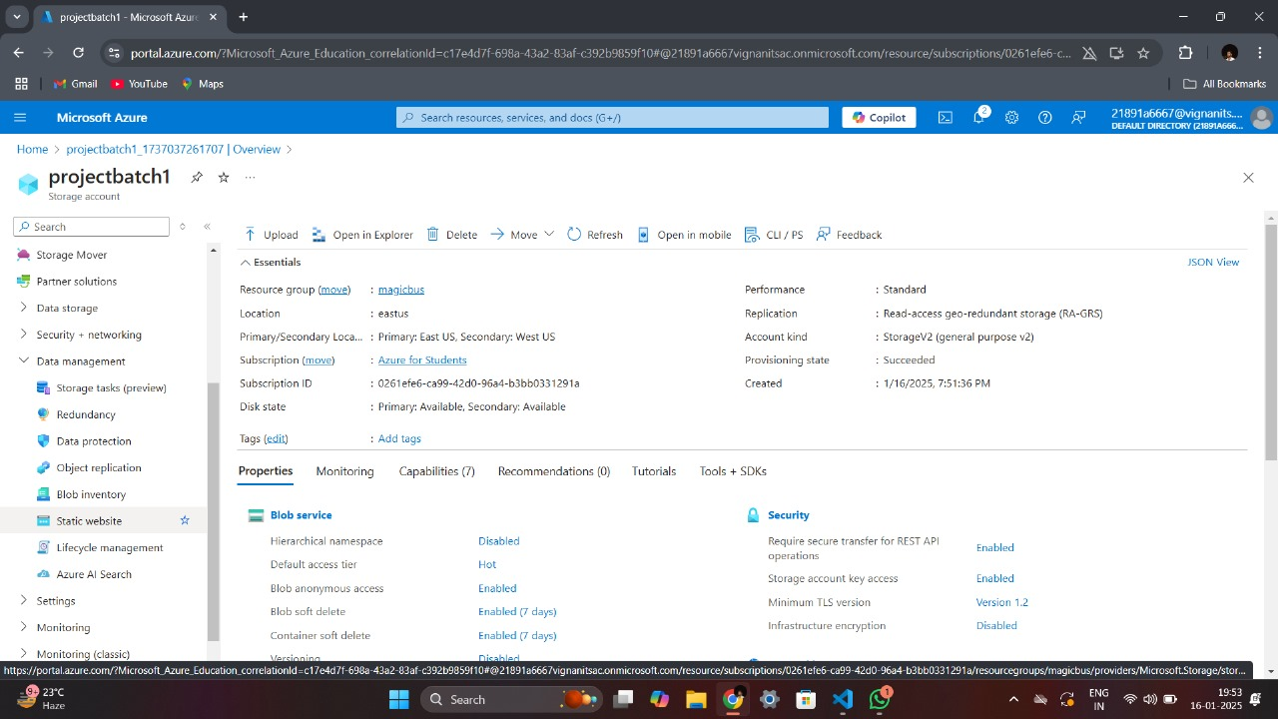

Slide 10
Enable Static Website Hosting:
Enable the Static Website feature within the Storage Account.
Specify the index document

Slide 11
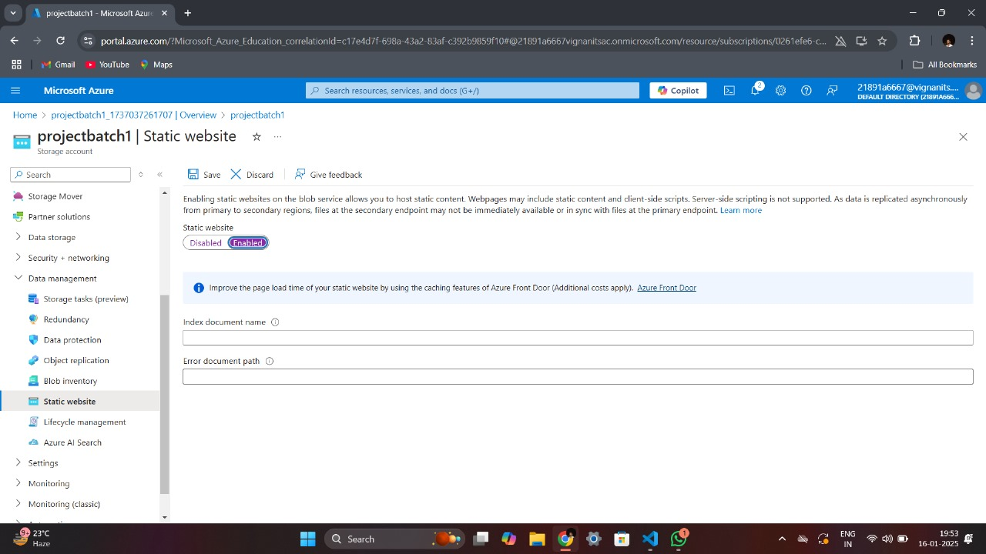

Slide 12
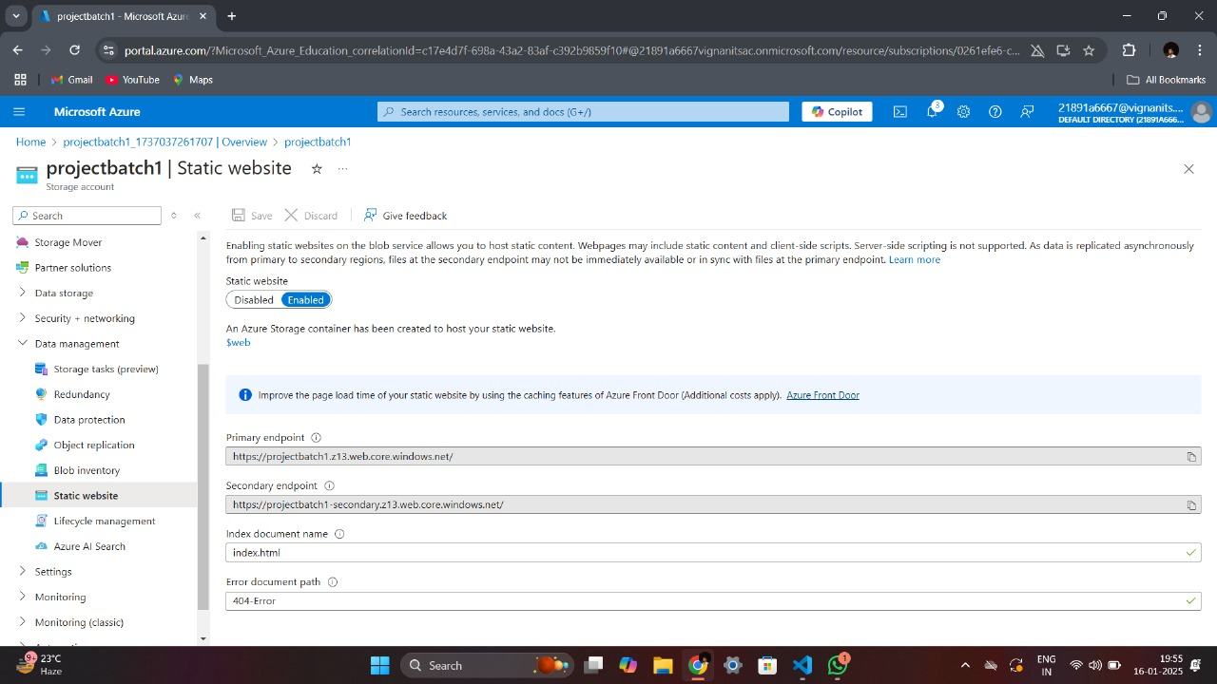

Slide 13
Upload Website Files:
Access the $web container in the Storage Account.
Upload the website files (HTML, CSS, images) using drag and drop or manual upload.

Slide 14
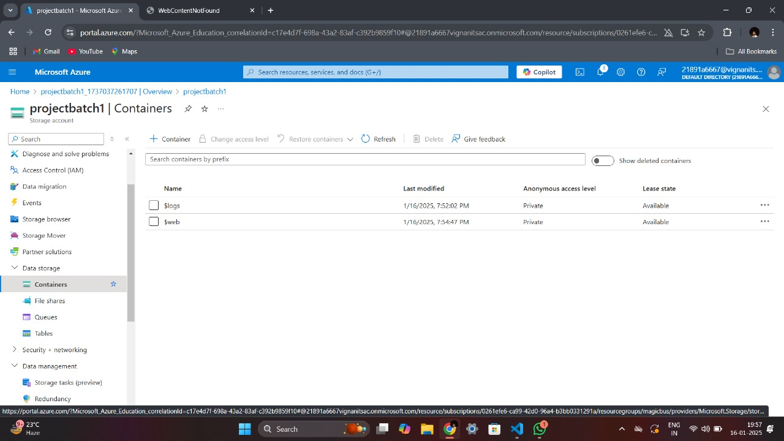

Slide 15
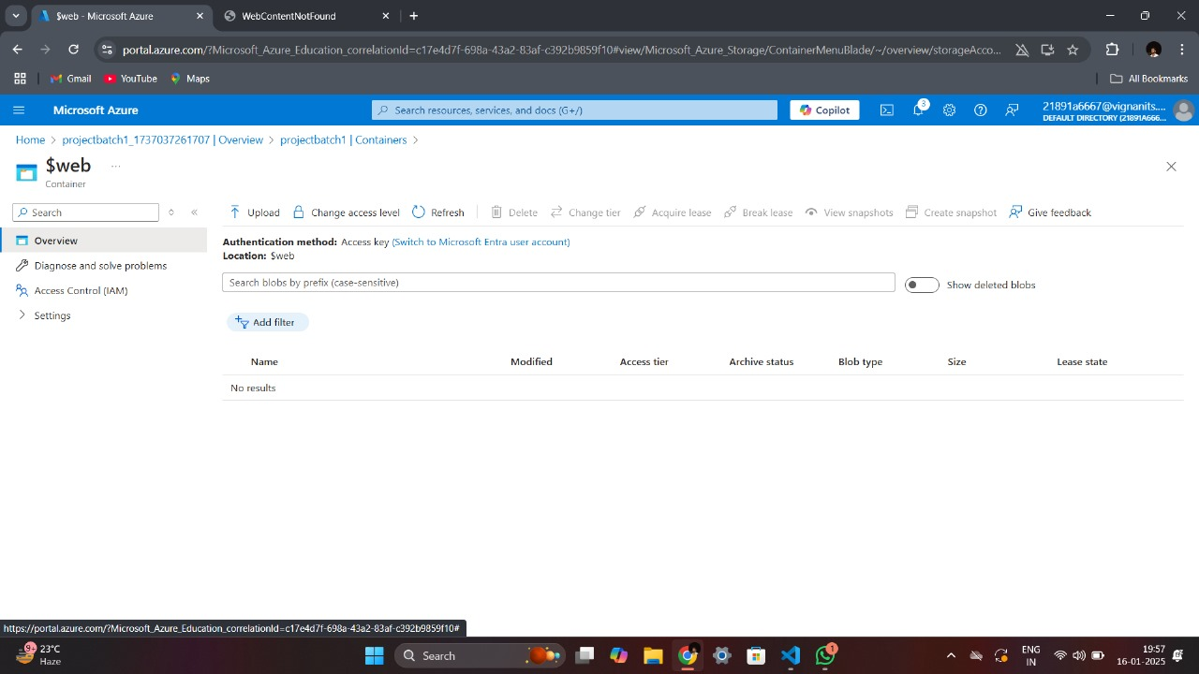

Slide 16
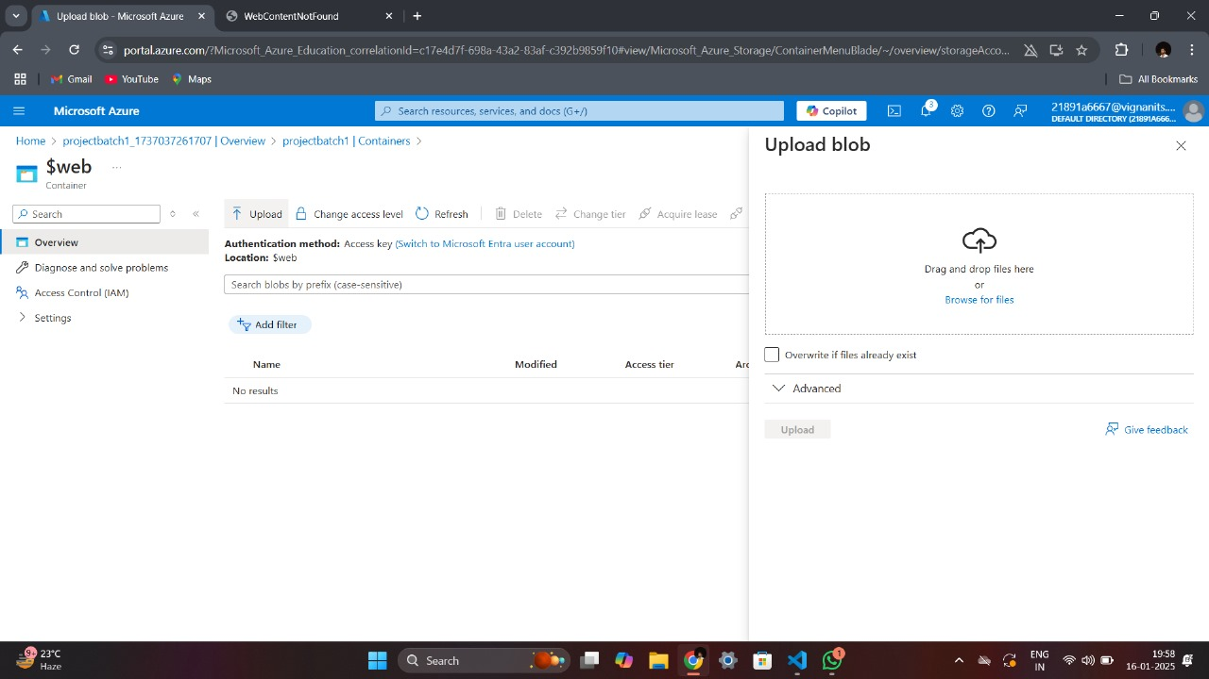

Slide 17
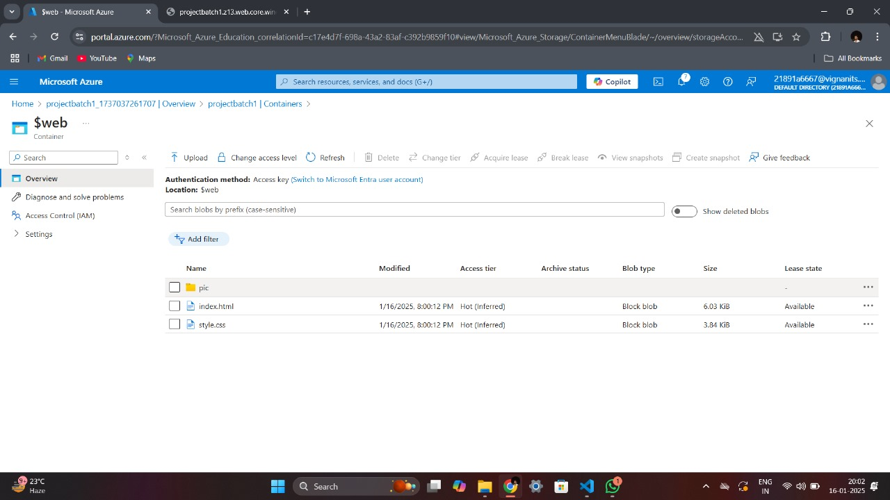

Slide 18
Testing
Test the Static Website:
Retrieve the Primary Endpoint URL from the Static Website settings.
Paste the URL into a browser to ensure proper deployment.

Slide 19
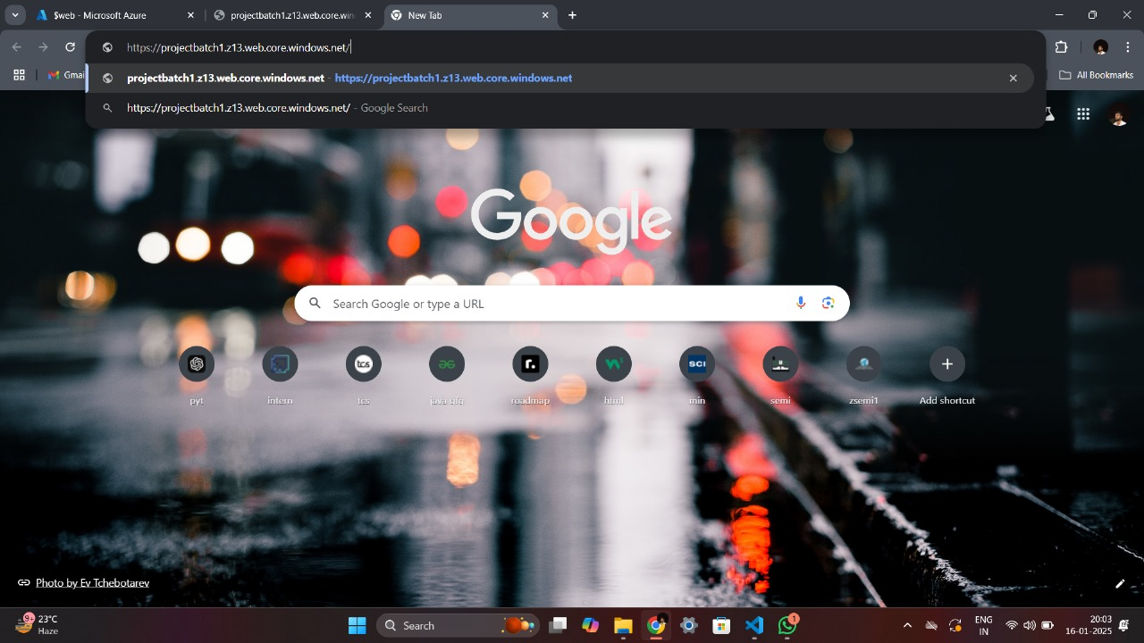

Slide 20


Slide 21
ADVANTAGES & BENEFITS
Cost-Effective: Minimal hosting costs compared to traditional web hosting services.
Scalability: Automatically scales to handle traffic spikes without additional setup.
High Availability: Built-in redundancy ensures high uptime.
Global Reach: Azure's global data centers ensure fast content delivery to users worldwide.

Slide 22
CONCLUSION
The simplicity and effectiveness of hosting static websites on Azure Storage Accounts.
By following these steps and leveraging the benefits of Azure Storage, users can deploy and host a static website with minimal complexity, ensuring optimal performance, scalability, and global reach.

Slide 23
THANK YOU

